Slide 1
Subroutines and Stack

Slide 2
Subroutines
Just like functions of C++
Identified by a label
Executes a set of instructions
Based on input parameters
Without any input parameters
Provides output too
A set of Call and Ret defines a piece of code as a “subroutine”.

Slide 3
Parameters Passing
Input/Output parameters are communicated through
Registers or Memory Labels
Through stack
We’ll see this later
Possible and legal to pass some parameters through stack and others through registers or memory variables

Slide 4
Example 1.0: A subroutine to add 9 to the value given in bx
1- bx is acting as an input parameter for subroutine.
[org 0x0100]
mov bx, 4
call addconst
Jmp exit
addconst:
add bx, 9
ret
exit:
mov ax, 0x4c00
int 0x21 ;At the end of the subroutine, bx will have the resultant value/output.
2- Keyword ‘call’ is specifying that addconst is a subroutine. Keyword call will make the control move to label addconst directly
5- Ret will bring the control here and this instruction will execute now.
3- A code block that has a set of instructions to execute.
4- keyword ‘ret’ will compel the control to go back to the instruction that is written next to ‘call addconst’.

Slide 5
Example 1.1: A subroutine to add 9 to the value given in a memory label
[org 0x0100]
mov bx, [Mydata]
call addconst
Jmp exit
addconst:
add bx, 9
ret
exit:
mov ax, 0x4c00
int 0x21
Mydata: dw 6
This subroutine is same as the previous one, the only difference is that parameter is being passed through a memory label and result/output is in a register bx
Similarly, at the end of your subroutine, you can place your output in a memory label too.

Slide 6
Stacks
A data structure that stores values in it.
Imagine it as a vertical space where each value to save is placed on the previously places value.
Two basic operations
Push: Places value on the top of stack.
Pop: Removes value from top of stack.
Peek: View inside the stack to read/ write values without increasing/decreasing stack’s height.

Slide 7
Stack
The stack is empty initially.
Push 2
2

Slide 8
Stack
Push 11
11
2

Slide 9
Stack
Push 6
6
11
2

Slide 10
Stack
mov ax, -45
Push ax
Always remember that whenever you push a register say ax on stack, only its ‘contents’ are placed on stack and thus you can use ax in any way you want to. ax itself physically doesn’t go and sit over the top of stack!
-45
6
11
2

Slide 11
Stack
Consider the stack and current values in registers
Registers | Current Values
ax | -45
bx | 5
cx | 6
dx | 7
-45
6
11
2

Slide 12
Stack
Pop bx
Registers | Current Values
ax | -45
bx | 5 -45
cx | 6
dx | 7
-45
6
6
11
11
2
2

Slide 13
Stack
Pop dx
Registers | Current Values
ax | -45
bx | -45
cx | 6
dx | 7 6
6
11
11
2
2

Slide 14
Function Calling in Assembly
Courtesy: Syeda Farwa Batool

Slide 15
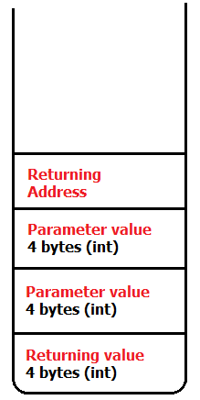
Function Calling in C++
int sum(int a , int b)
{
int c = a + b;
return c;
}
int main()
{
int a = 10;
int b = 20;
int c = sum(a,b);
cout << c;
}
What happed at this line
Courtesy: Syeda Farwa Batool

Slide 16
Function calling in Assembly
In Assembly you have to perform each step by yourself.
There is stack in assembly which resides in SS (Stack segment) and pointed by SP(Stack pointer)
Courtesy: Syeda Farwa Batool

Slide 17
Registers Associated with Stack
SP
points to the top of stack
Affected by push and pop instructions
BP:
You can see any cell of stack via bp i.e. ‘peek’.
Any call’s value in the stack can be over-written using bp
Assembly Instruction | Corresponding Operations
push ax | SP ←SP – 2 [SP] ← AX
Assembly Instruction | Corresponding Operations
pop ax | AX ← [SP] SP ←SP + 2

Slide 18
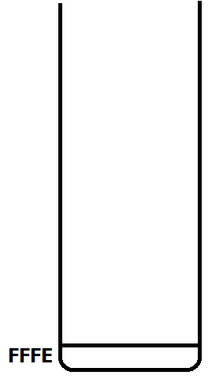



Backend Elaboration
Assembly Instruction 1: mov ax, 5 push ax
MOV AX,5
Initially SP was pointing at FFFE
push ax (this value should be 16 bit)
Value of ax will be placed at SS:SP-2
Current value of SP = FFFC,
Now the value of SS:SP is 5
Assembly Instruction 2: pop cx
pop cx (this register should be 16 bit)
Value of cx is 5
Current value of SP = FFFE,
Courtesy: Syeda Farwa Batool

Slide 19
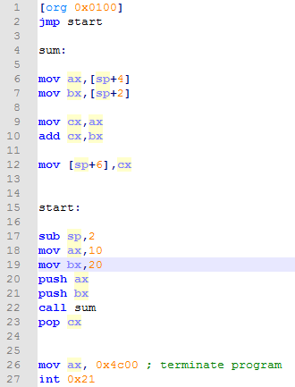
Error at these lines, we can not de-refer sp (stack pointer).
Courtesy: Syeda Farwa Batool

Slide 20
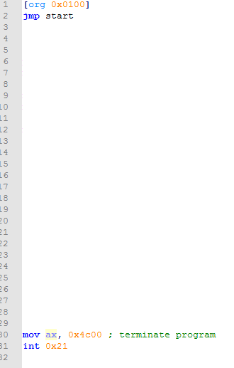

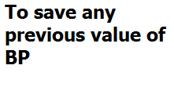












Courtesy: Syeda Farwa Batool

Slide 21
Subroutines De-Facto
The unit of stack operation is word. i.e. you can only push/pop words to/from stack.
Always save the registers (that you are using in your subroutine) before the actual subroutine instructions i.e. push.
Always restore the states registers actually had before you entered subroutine i.e. pop.
Refer to your input parameters or local variables present in stack via bp only.
It is your responsibility to clear the stack every time you use it.

